Slide 1
Yelp Dataset Challenge
By: Joshua Chang, Jae Choi, Edward Kang, Rachel Pang

Slide 2
Yelp Dataset Challenge
Yelp has had 8 rounds of of dataset challenges. This year, they are on their 9th round and are providing everyone with their largest dataset ever.
We’ve decided to take on this challenge which contained millions of observation across 5 separate datafiles.

Slide 3
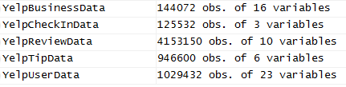
The Datafiles
Business - Business ID, Business name, neighborhood, address, city, state, postal code, latitude, longitude, star rating, review count, open/closed, attributes, categories, hours, type.
User - User ID, name, account age, review count, # of friends (social media interaction), review count, User’s Elite status, review vote ratings, overall average star score of reviews, compliments received, type
Review - Review ID, User ID, star rating, date, review text, review votes (useful, funny, cool), type.
Check in - Time, Business ID, type.
Tip - Business ID, User ID, text, date, likes, type

Slide 4
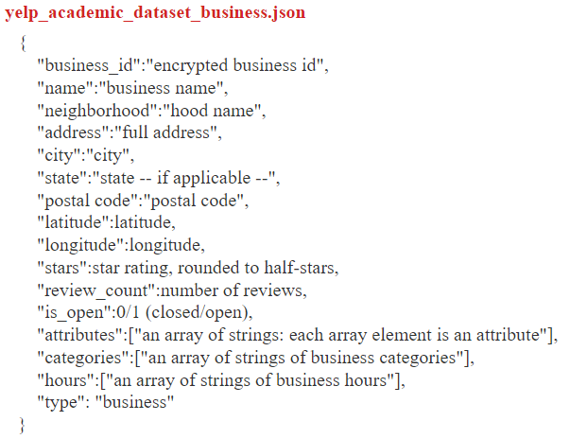
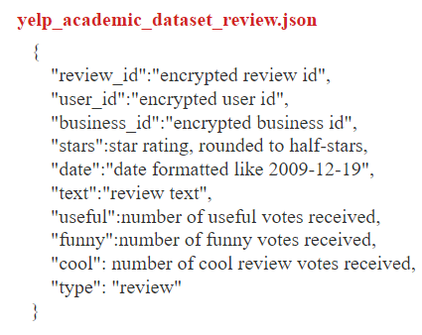
The Data

Slide 5
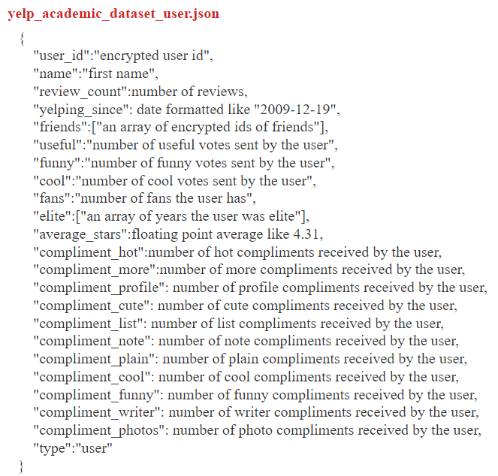
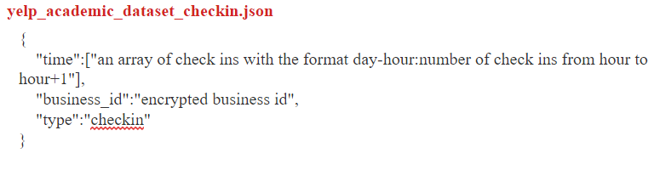
The Data

Slide 6
Objectives
Our objectives after careful observation include:
(1) focusing on a general analysis of eateries/restaurants
(2) joining the reviews, tips, and business datasets to analyze the expertise/credibility of users
(3) text mining in order to find good and bad reviews
For the most part we want to focus on businesses that are located in America, our area of interest, which will be applied to the restaurant businesses and to the reviews text mining.

Slide 7
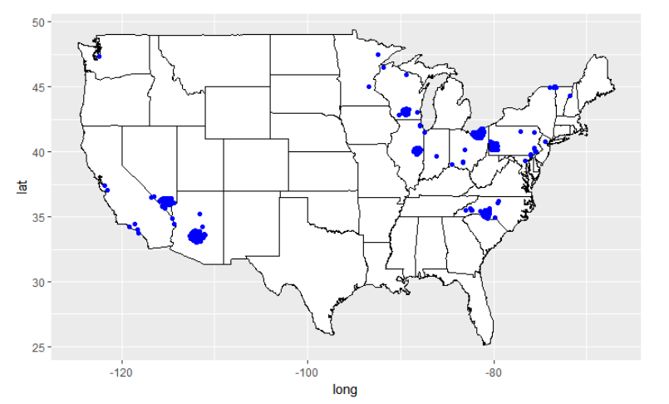
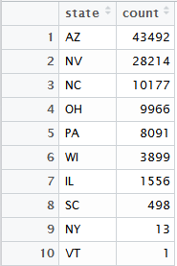
Businesses in America

Slide 8
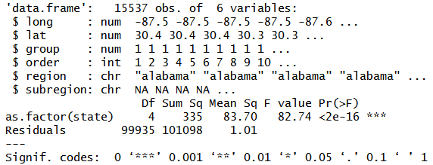
Top 5 States in Our Dataset
ANOVA test to test mean average star rating in each State’s businesses
P-value <2e-16 which is less than alpha= 0.05
Arizona
Nevada
North Carolina
Ohio
Pennsylvania

Slide 9
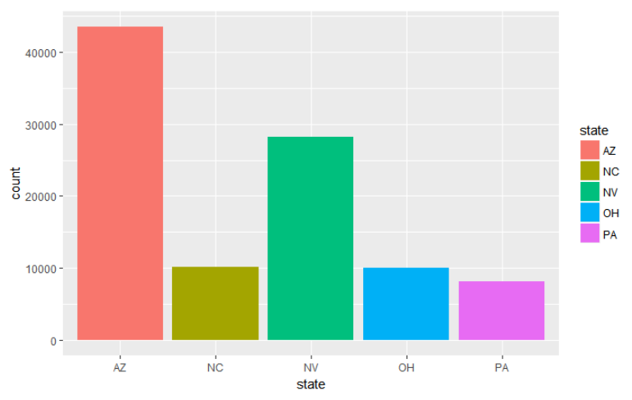
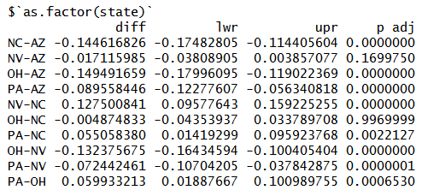
Top 5 Most Number of Businesses in America
Tukey HSD for multiple comparisons of mean average ratings per State

Slide 10
Interpretations of Results
After we performed the ANOVA test, we got a p-value equal to <2e-16, which is less than alpha = 0.05 which tells us that at least one of the states had a significantly different mean average star rating than the others. We performed the Tukey HSD test to test for multiple comparisons of means and found that all the combinations of states except those of Nevada and Arizona and Ohio and Pennsylvania had significantly different mean average star ratings.

Slide 11
Attributes Of Restaurants
First… Filter Businesses in America to only Restaurants in America.
Attributes include:
“Ambiance:{romantic: false, classy: false, hipster: true…”
“BusinessAcceptsCreditCard: True”
Attribute focus: “Alcohol: none”, “Alcohol: full_bar”, “Alcohol: beer_wine”
17,112 do not serve alcohol
20,925 serve alcohol

Slide 12
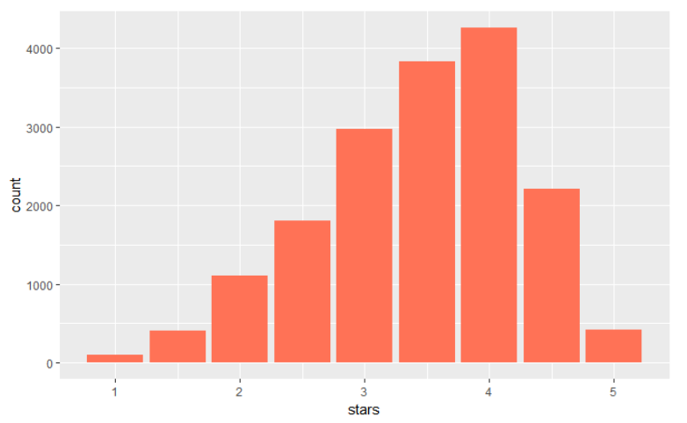
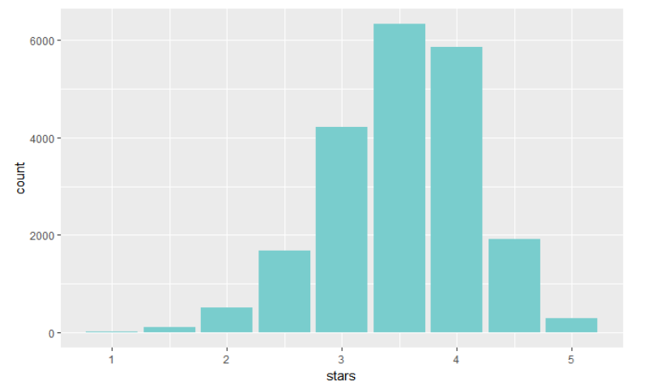
Alcoholic vs. NonAlcoholic Restaurant Ratings with Barplots
Serves Alcohol
Does not serve alcohol

Slide 13
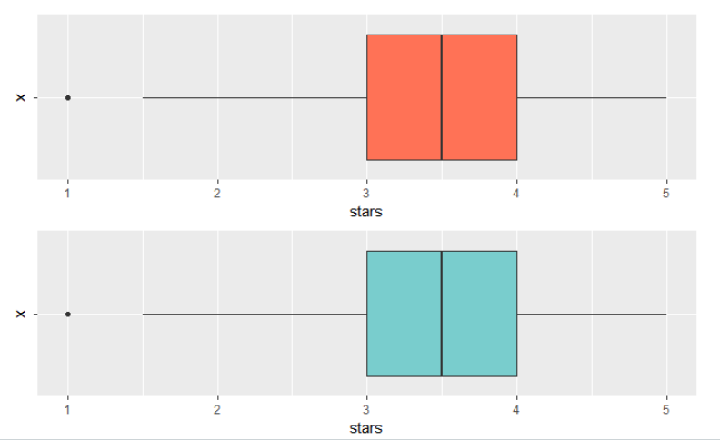
Alcoholic vs. NonAlcoholic Restaurant Ratings with Boxplots

Slide 14
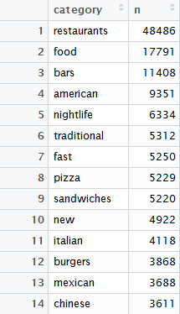
Text Mining Categories
In order to see which ethnic restaurants were in the top 5 and
bottom five, we had to do a little text mining to see which
categories were prominent in our observations
tidyRestaurants <- BusAmericaRestaurants %>%
unnest_tokens(category, categories)
The Top 5 Ethnic Food Groups: American, Italian, Mexican, Chinese, Japanese
The Bottom 5 Ethnic Food Groups ( from those that appeared at least 100 times):
African, Persian, Iranian, Lebanese, Taiwanese

Slide 15
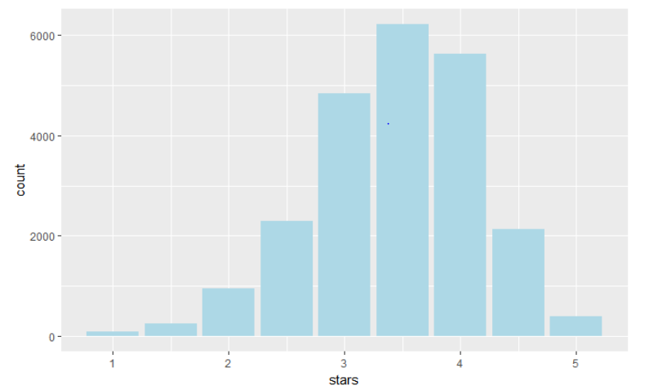
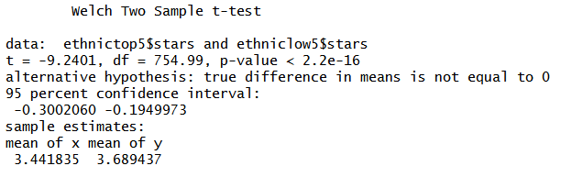
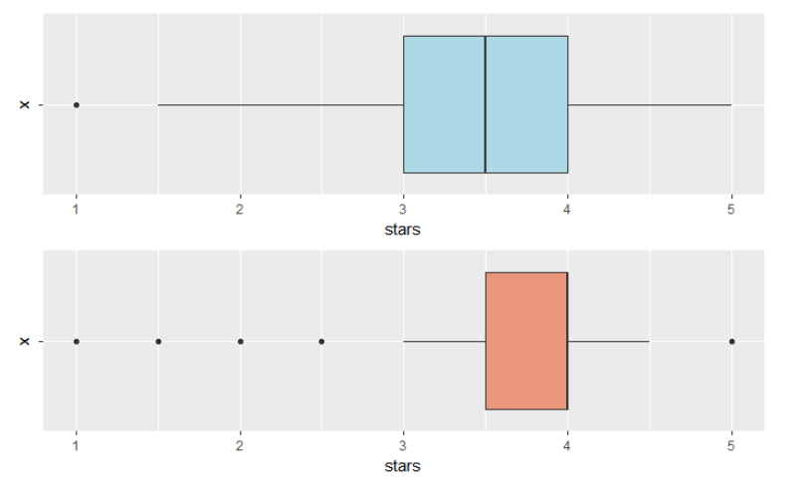
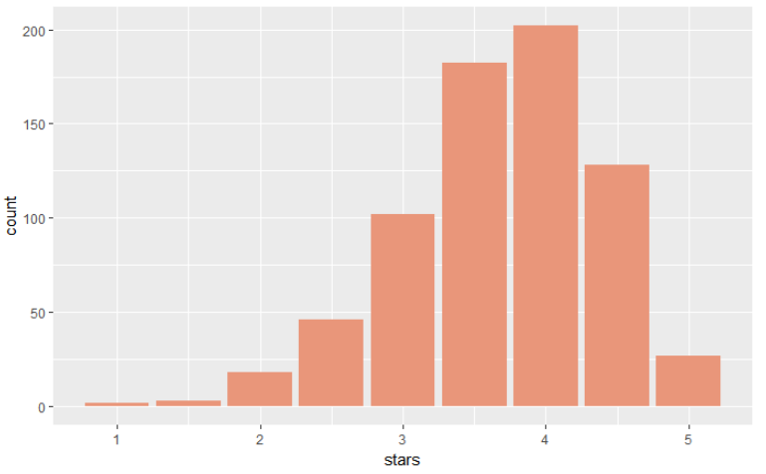
Means Comparison: Top 5 & Bottom 5 Ethnic Food Groups Ratings

Slide 16
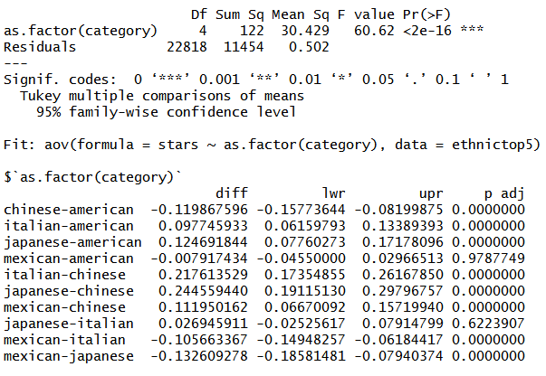
Difference of Mean Average between Top 5 Ethnic Food Groups

Slide 17
Interpretation of Results
We wanted to test if there was a difference in means of average star ratings for each of the top five ethnic groups. We performed the ANOVA test to test whether or not the population means were equal to each other. The p-value we observed, <2e-16, was less than alpha = 0.05 so we concluded that at least one of the population means were different from each other.
After performing the post hoc test, the Tukey HSD test, we saw that only the Mexican-American and Japanese-Italian combinations had mean average star ratings that were not different from each other at 0.05 significance level.

Slide 18
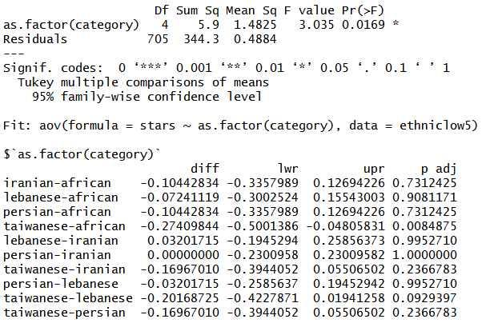
Difference of Means between bottom 5 ethnic restaurants

Slide 19
Interpretation of the Results
We then went on to perform another ANOVA test in the bottom five ethnic restaurants. Similarly we got a p-value less than alpha = 0.05 and concluded at least one of the population means were significantly different from each other.
We performed the Tukey HSD test once again and observed that only the combination of Taiwanese and African restaurants had mean average star ratings that were different from each other at 0.05 significance level.

Slide 20
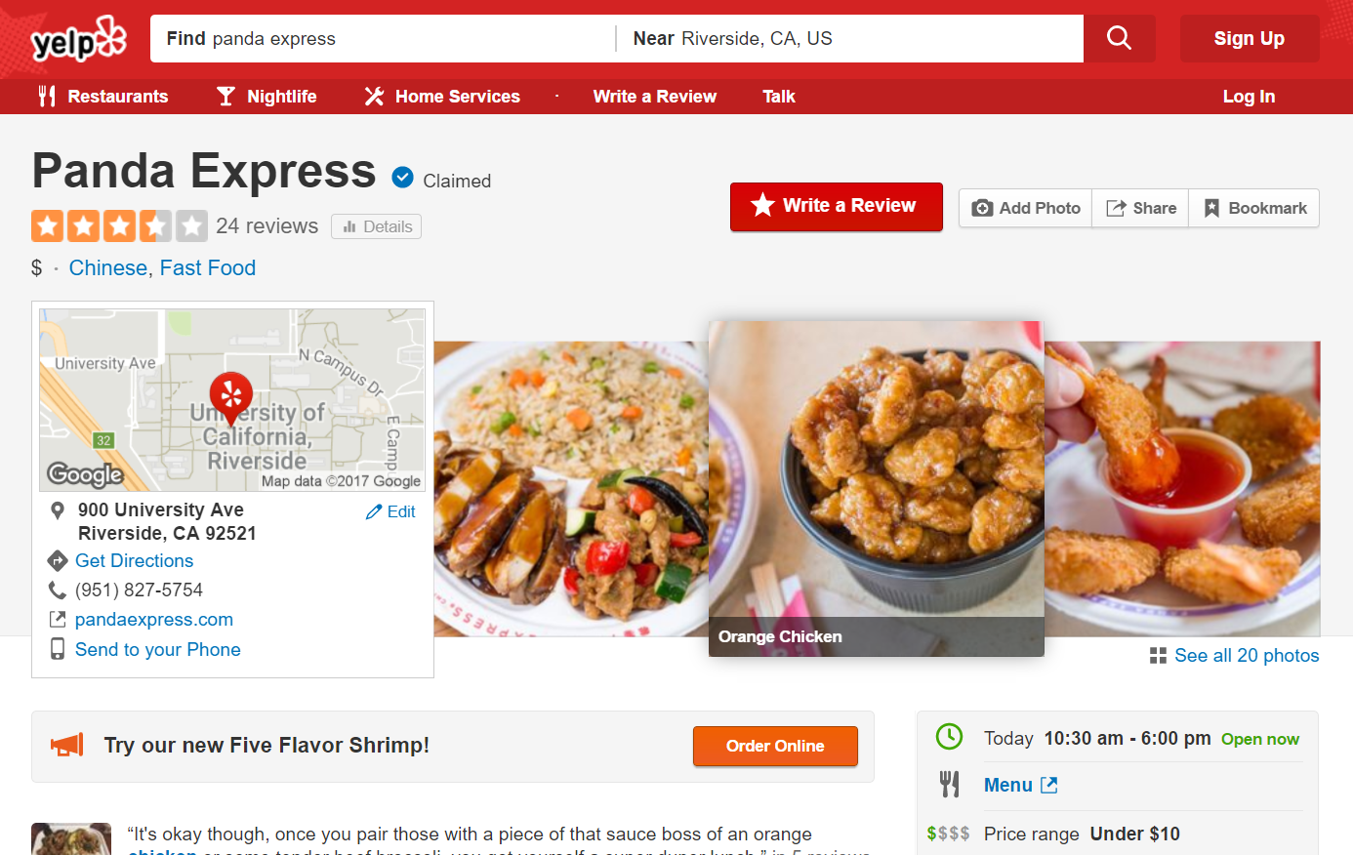
Review Accuracy and User Credibility

Slide 21

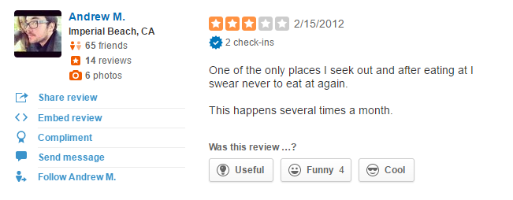
Review Accuracy and User Credibility

Slide 22
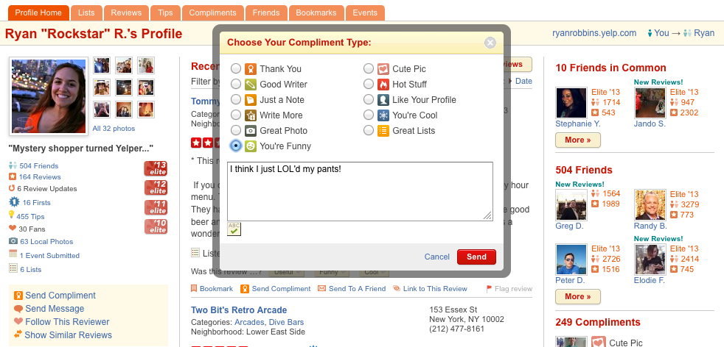
Review Accuracy and User Credibility

Slide 23
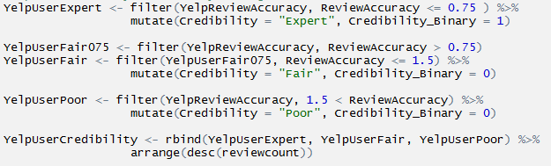
Review Accuracy and User Credibility

Slide 24
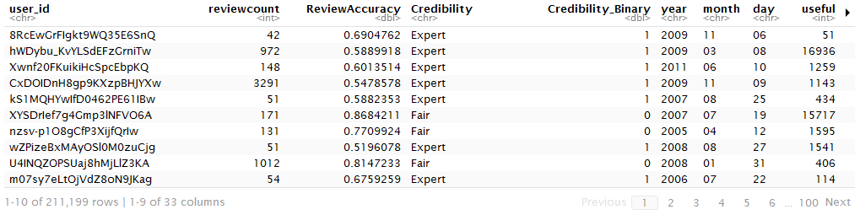
Review Accuracy and User Credibility

Slide 25
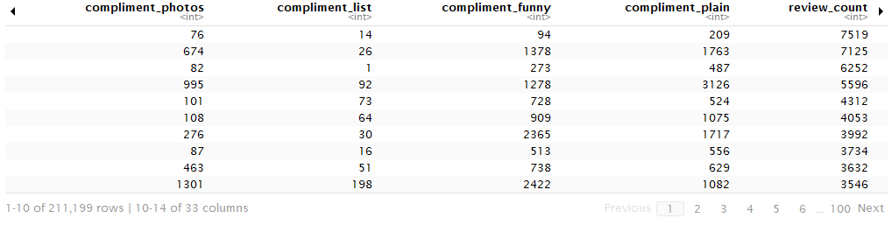
Review Accuracy and User Credibility

Slide 26
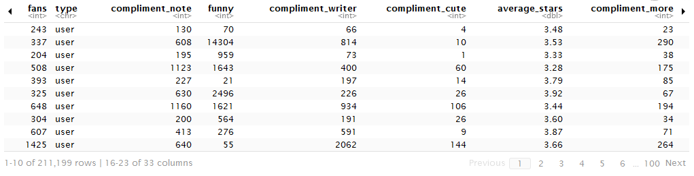
Review Accuracy and User Credibility

Slide 27
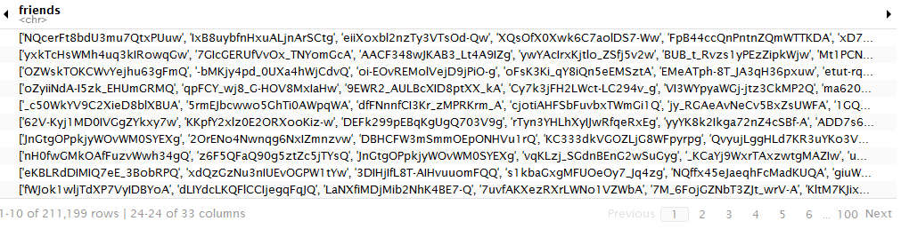
Review Accuracy and User Credibility

Slide 28
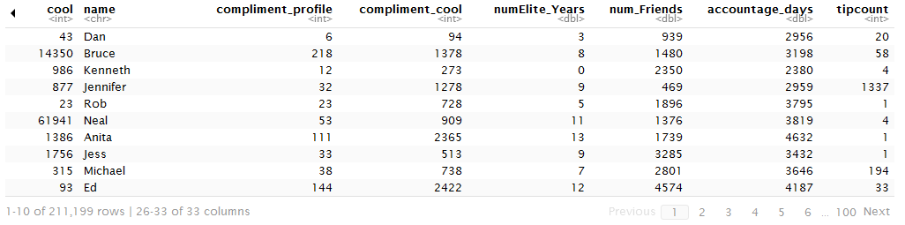
Review Accuracy and User Credibility

Slide 29
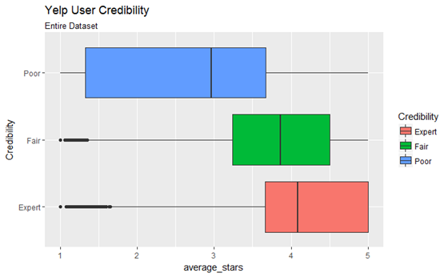
Review Accuracy and User Credibility
Unfiltered User Data

Slide 30
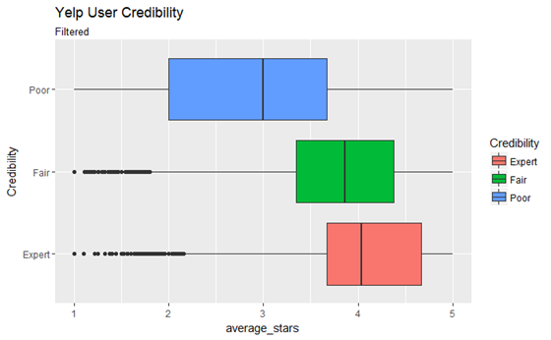
Review Accuracy and User Credibility
Filtered Data
(tipcount)

Slide 31
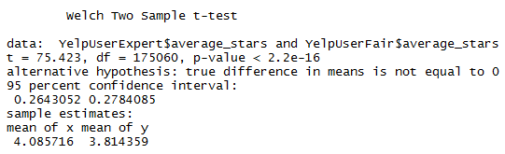
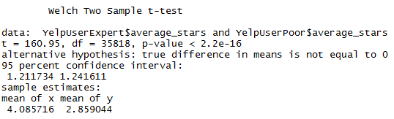
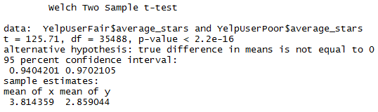
Two-Sample T-Tests for each User Class’ Ratings

Slide 32
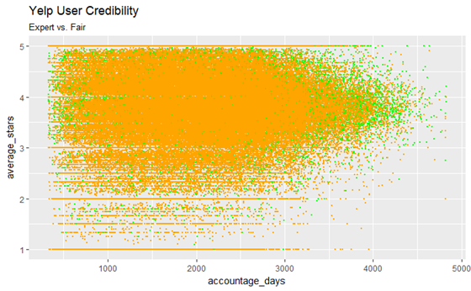

Slide 33
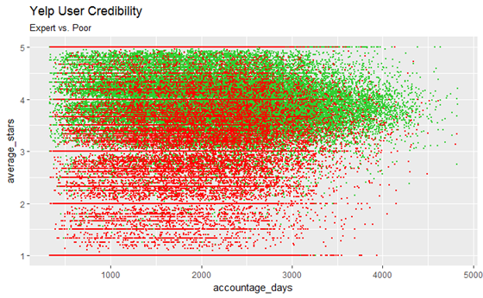

Slide 34
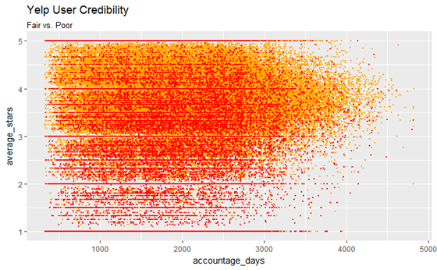

Slide 35
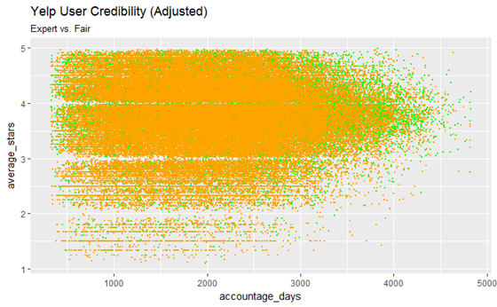
Cleaned Data
No whole # averages

Slide 36
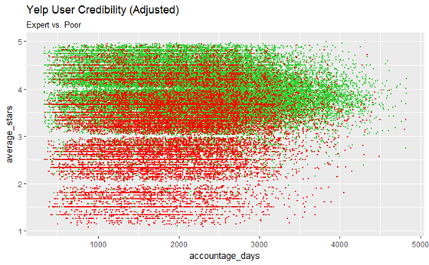
Cleaned Data
No whole # averages

Slide 37
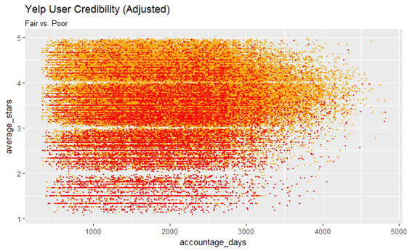
Cleaned Data
No whole # averages

Slide 38
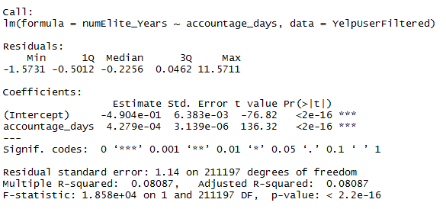
Review Accuracy and User Credibility
Account age in relation to Number of Elite Status Years

Slide 39
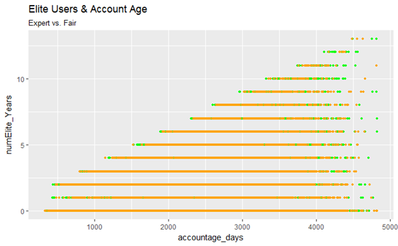
Account age in relation to Number of Elite Status Years

Slide 40
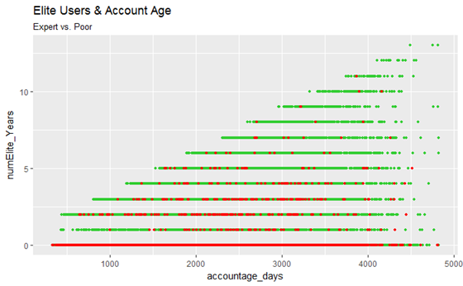
Account age in relation to Number of Elite Status Years

Slide 41
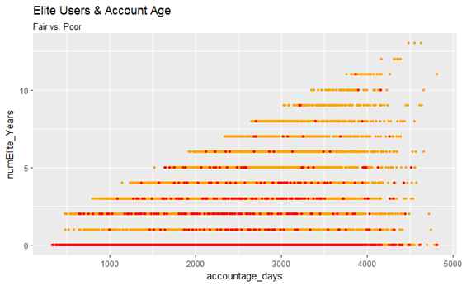
Account age in relation to Number of Elite Status Years

Slide 42
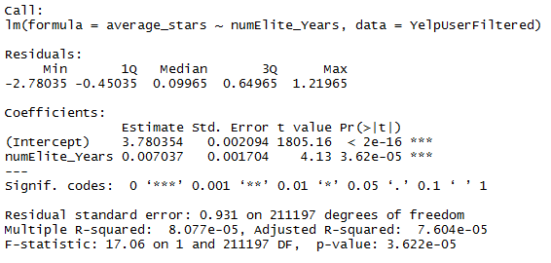
Review Accuracy and User Credibility
Number of Elite Status Years in relation to Average User Stars

Slide 43
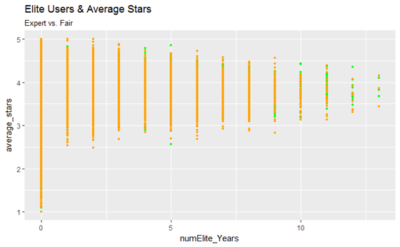
Number of Elite Status Years in relation to Average User Stars

Slide 44
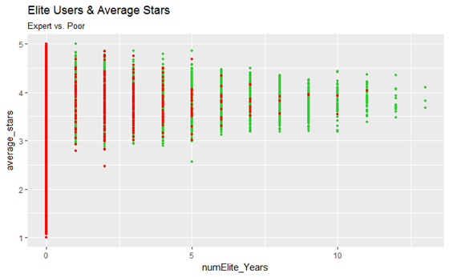
Number of Elite Status Years in relation to Average User Stars

Slide 45
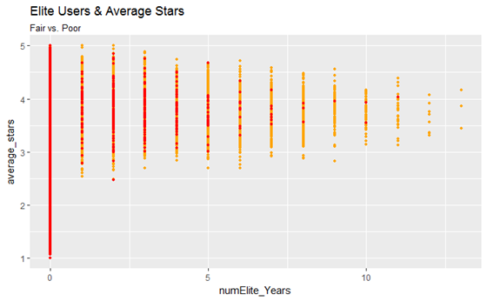
Number of Elite Status Years in relation to Average User Stars

Slide 46
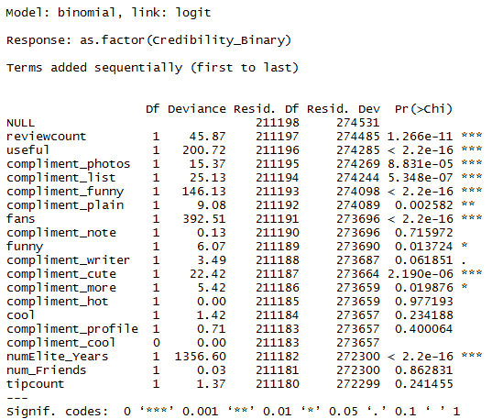
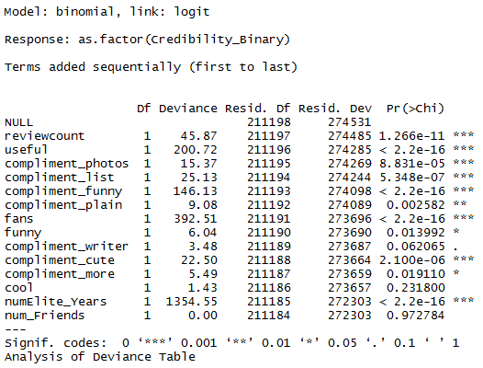
Which factors influence Expert Credibility?

Slide 47

Analysis of Deviance Table to Compare Models
Factors that contribute whether or not a Yelper is of Expert Credibility:
Review Count, Useful, # of Fans, Funny, Compliment: Photos, List, Funny, Plain, Writer, Cute Pic, More

Slide 48

Word Cloud of Bad reviews

Slide 49

Word Cloud of Good Reviews
Notes:
If I had more time I would conduct a test of two population proportion means to see which words are not significicant and filter them out and make another word cloud.
Word Bad Good Total
'apple' 23 34 111
'banana' 34 23 340

Slide 50

Visualization of word counts
Good Reviews vs Bad Reviews
Good Reviews vs Average Reviews

Slide 51

Visualization of word counts

Slide 52
Creating a classification model from the review
Use Bag of Words to generate features from all of our review examples.
Example: only two reviews exist in our sample.
Review 1: The hot dog looked very appealing on this day
Review 2: The dog looked very appealing on this great day
Approach
“Tokenize” each word of the reviews into tokens.
Create our feature space from these tokens.
Counts of each of these features becomes how many many times it appears in each review.

Slide 53

Creating a classification model from the review
Use Bag of Words to generate features from all of our review examples.
Example: only two reviews exist in our sample.
Review 1: The hot dog looked very appealing on this day
Review 2: The dog looked very appealing on this great day
Our Document Term Matrix

Slide 54
Problem : High Dimensionality
Even a simple sentence will make us work in 10-D
Our sample we are working with has 113,369 unique words. Our feature space has 113,369 dimensions.
Solution : Logistic Regression with L1 Penalization

Slide 55

Logistic Regression Code
F
Features: Count of each word within the bag of words
Label : TRUE(>= 4 stars) FALSE (<= 3 stars)

Slide 56

Logistic Regression ROC Curve
Max AUC
= 0.932
Test set accuracy
= 0.933
Notes:
We could use the model to flag users who continuously post misleading reviews
The area under the ROC curve (AUC) is a measure of how well a parameter can distinguish between two diagnostic groups (diseased/normal).
So if you take one good review and one bad review as a random sample, and out of those two you assign a prediction of which one is good, and which one is bad. You will get it right 93.33% of the time.
the true positive rate (Sensitivity) is plotted in function of the false positive rate
Ratio of reviews that are tested correctly as good, over ratio of reviews tested as bad when its actually good
At this point, you may be wondering what this area number really means and how it is computed. The area measures discrimination, that is, the ability of the test to correctly classify those with and without the disease. Consider the situation in which patients are already correctly classified into two groups. You randomly pick on from the disease group and one from the no-disease group and do the test on both. The patient with the more abnormal test result should be the one from the disease group. The area under the curve is the percentage of randomly drawn pairs for which this is true (that is, the test correctly classifies the two patients in the random pair).
If I were to improve this model, II would use bi-grams

Slide 57

Thanks

